Slide 1

Software Quality Assurance
Dr. Zaki Murtaza
MCS
Chapter 3 for SQE

Slide 2


Quality Assurance
Quality Assurance is to ensure that
  > ensure defect free product
  > damage control from remaining defects
QA activities can be classified to be used for specific applications

Slide 3
QA classification
Different activities attempt to
  Prevent
  Eliminate
  Reduce
  Contain
defects from the software system
QA activities are going to be classified according to the activities

Slide 4
QA – Prevention, Reduction, Containment
Failures
Errors
Fl1
Fl2
Fl3
Fl4
Fl5
E1
E2
E3
E4
Faults
F1
F2
F3
2. Reduction through Fault
removal
1. Prevention through Error
blocking & removal
3. Containment of failures
Preventing defect
from escaping into execution

Slide 5
Stages of QA activities
Defect prevention through error blocking or error source removal:
  QA activities prevent certain types of faults from being injected into the software
    Eliminating certain error sources
      ambiguities
      human misconceptions
    Fault prevention or blocking
      directly correcting or blocking these missing or incorrect human actions.

Slide 6


Defect Prevention Activities
Human Misconception or Lack of Knowledge - (root cause)
  Education/training - (prevention)
Imprecise Requirements, Design and Implementation, and Testing
  “Improved” or formal methodologies
Non-conformance in Process or Standards
  Process and standard enforcements
Lack of Technology or Tools
  Adoption of appropriate technology and tools

Slide 7
Stages of QA activities
Defect reduction through fault detection/ removal:
  QA activities identify and remove faults
  Most traditional QA activities are a part
    Inspection detects and removes faults from
      Software code
      design
    Testing removes faults based on
      Related failure observations during execution

Slide 8
Defect Reduction Activities
It is not possible to have a 100% effective error prevention activity. Thus we need to perform fault removal to get defect reduction:
  Inspection/Review
        done by inspectors
  Testing
        Test cases (dev,exec,observ, record)
  Other techniques: Prototyping, Simulation, Fault Tree Analysis, risk identification

Slide 9
Stages of QA activities
Defect containment through failure prevention and containment:
  Containment failures to local areas or limiting damage
  Two generic ways:
    Fault tolerance by breaking the casual link between local faults and failures
    Fault tolerance to avoid catastrophic outcomes, may include non-software, physical methods. e.g. physical nuclear reactor design

Slide 10
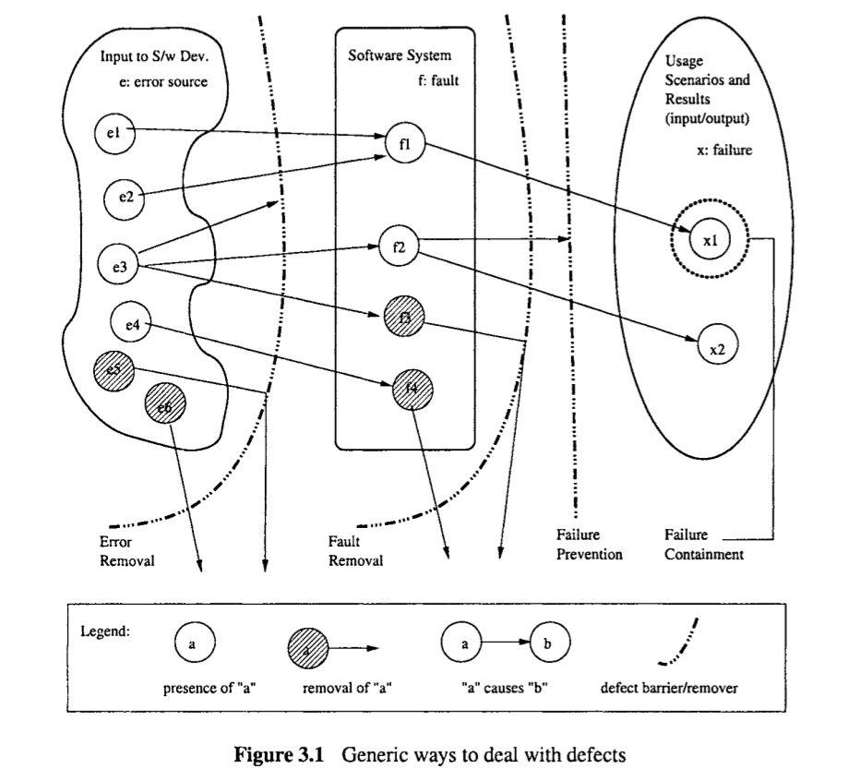

Slide 11
Defect Prevention
Defect prevention to reduces
  Defect injections
  Cost to deal with injected defects
If Human misconceptions are sources
  Educate and train humans
If faulty designs/ implementations are cause
  Use formal methods for specifications

Slide 12
Defect Prevention
If process and standards are not being followed
  Follow standards
If tools/ technologies are missing
  Use appropriate tools to reduce fault injections in softwares

Slide 13
Defect Prevention - Methods
Education and Training
  What should we train for?
Formal Methods
  What methods should be used?
Other defect prevention techniques
  What techniques should be used?

Slide 14
Education and Training
Product and domain specific knowledge
  Familiarity with the product type /domain
    e.g. special needs of embedded software or wireless sensor networks
Software development knowledge and expertise
  Key skills in software engineering

Slide 15

Education and Training II
Knowledge about development methodology, technology and tools
    Knowledge about the certain statistical methods or formal verification
    HPC applications needs knowledge about optimizations among other things
This point deals with the
methods, techniques and tools

Slide 16
Education and Training III
Development process knowledge
  Personnel should understand development process
    e.g. in incremental development, individual should know about how individual efforts and different increments fit together.
This point deals with primarily
the understanding of the
process models being used

Slide 17
Formal Method
Provides way to eliminate errors and their “effects”, includes
  Formal specification
  Formal verification
Formal Specification
  An unambiguous set of specs based on
    Customer requirements
    Environmental constraints
    Design intentions

Slide 18
Formal Methods II
Formal Verification
  Checks conformance of software design/code against formal specifications
    Fault-free software w.r.t. Formal specs
Basic questions:
  What is the correct behavior?
  How to verify it?

Slide 19
Formal Method III
Techniques to answer basic questions
  Check a program against set of formal conditions before program execution and after it
    Set of per-conditions
    Set of post-conditions
  Mathematical approach
    Program calculus or functional approach
    Difference in proof procedures
What are these?
See example

Slide 20
Formal Methods - Example
New Slide
Ref: Zelkowitz M. V., The role of verification in the software specification process, Advances in Computers 36, Academic Press (1993) 43-109.
Program Verification:
  From a flowchart of a given program is annotated as,
    Associate with each input arc a predicate before a program node (pre-condition)
    the node
    The predicate on the output condition (post-condition)

Slide 21
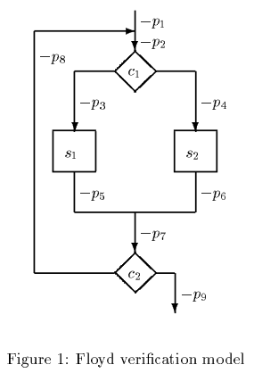
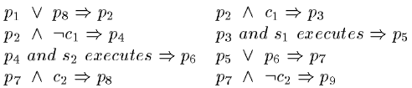
Example Program
New Slide
To show that the program in the fig is correct, we have to prove the following propositions:
Verification: given a precondition is true, postcondition is true as well. (All ver., prog ver.)

Slide 22
Formal Methods IV
Partial checking techniques
  Check for certain modules not the program as a whole
Drawbacks
  High cost for the formal methods
  Difficult activities for a normal worker to adapt to
  Little or no automation for the processes

Slide 23
Other Defect Prevention Techniques
Software methodologies to have “lean software” instead of a “fat software”
  Disciplined methodologies, reducing wastage of resources, activities
Better project management and conformance to standards
Use of specific software tools
  Source code editors with functionalities
  Intellisense use

Slide 24
Defect Reduction
Defect prevention cannot be 100%
Techniques to remove of as many of the injected faults
Questions
What kind of defects are we taking about?
Which two kind of techniques may be used for defect reduction?

Slide 25
Lecture 2 -Week 4

Slide 26
Defect Reduction
Defect prevention cannot be 100%
Techniques to remove of as many of the injected faults

Slide 27
INSPECTION: Direct fault detection and removal
Critical examination of software artifacts by human inspectors
  Goal is to discover and fix faults
Involves critical reading/analysis of code/design/specs/test plans etc
Conducted by multiple human inspectors coordinating activities
Faults are detected

Slide 28
INSPECTION: Direct fault detection and removal
Individual faults to be removed and removal has to verified
Inspection activities are planned and followed-up
Formality and structure of inspections vary
  Very formal reviews/walkthroughs
  Fairly formal inspections
  Correctness inspections

Slide 29
Testing: Failure observation and fault removal
Testing is the execution of software and observation of program behavior or outcome
Failure observed?
  Analysis of execution record
  Location of fault(s)
  Fixing of fault(s)

Slide 30
Timing of testing activities
Prerequisite:
  Software to be tested should exist
  Not a prereq. to plan testing activity
Testing can be divided in phases:
  From coding phase to pre-release of product
Testing activities in these phases are categorized in different types of testing

Slide 31
Timing of Testing Activities
Types of testing:
  Unit testing
  Component testing
  Integration testing
  System testing
  Acceptance testing
  Beta testing
Sometimes the same thing
Faults are discovered in each phases
and faults discovered and fixed
are in related units

